Slide 1

Juice Laundry Post Campaign Report
Squeezed with care by: Conrad Tindall, Jairus Ang, and Bill Su

Slide 2




What is The Juice Laundry?
Organic cold-pressed micro juicery startup
Enjoyers (20-40 years old)
Purchase juice products for meal and refreshments.
Dieters (25-60 years old)
Purchase juice cleansing packages for cleansing and dieting.
Sold through online shopify platform and local farmer’s market.
Local Competitors
National Competitors

Slide 3
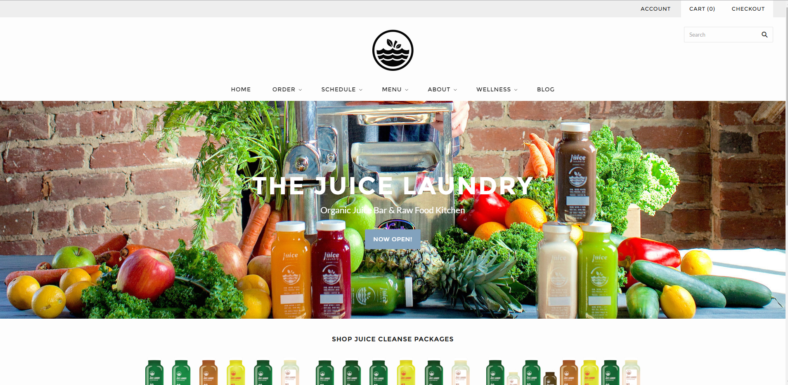

Slide 4
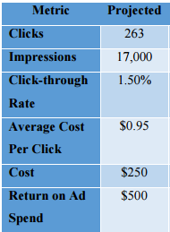
Campaign Overview
Main objective: Increase sales and brand awareness
Generate ROI of 100% ($500 for $250 expenditure)
Estimated number of total impressions to be 17,000
CTR of 1.5%
Generating 263 clicks
Average CPC across all keywords of about $0.95
Geotargeted Charlottesville, Richmond and surrounding areas in Virginia
Notes:
Geotargeted Charlottesville, Richmond and surrounding areas in Virginia

Slide 5
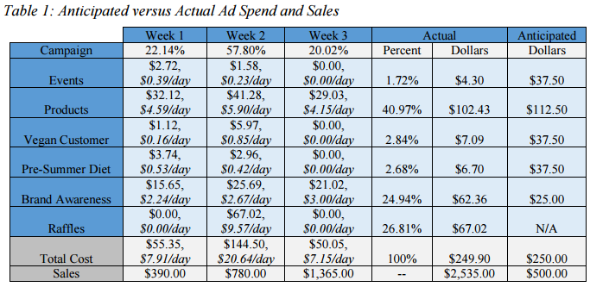
Operational Details
Notes:
1-2 slides describing how the budget was spent across campaigns and ad groups, over the three-week period.
1 slide on how the campaign was monitored, including governance procedures (i.e., how frequently campaigns were monitored, how often changes were made, decision-making process used to make changes, delegation of monitoring tasks, etc.).

Slide 6
Operational Details
Monitored the metrics daily/intra-daily
Made decisions and changes based on the metrics
Monitored the number of impressions for campaigns and paused it if there were too many. This was to prevent possible excessive clickthroughs from burning through the budget too quickly
Constantly monitored and redefined campaign strategy by rotating ad copies, eliminating expensive, high impression and low search volume keywords, as well as optimizing landing pages for quality score purposes
Made a huge change two weeks into the PPC campaign
When they saw campaigns that did not perform, they turned their focus to brand awareness and launched a new campaign
Notes:
constantly refined and added new keywords through an iterative process of monitoring keyword performance on CPC, average ad position, impressions, and clicks and optimizing bid amounts, ad copies, and landing pages to maximize ad rank

Slide 7
Evolution of Campaign Strategy
The team made three major changes to the originally planned strategy:
1) Pausing ineffective campaigns and ad groups
2) Adding the new raffles campaign
3) Optimizing ad ranks for brand and product keywords.
Notes:
2-3 slides describing major changes made (what, why, when). This includes changes to campaigns, ad groups, budget allocation, keywords, ad copy, etc.

Slide 8
Evolution of Campaign Strategy
Constantly added new keywords
Editted existing keywords, by changing ineffective broad match keywords into more specific spaces phrase or exact match iterations, thus increasing CTR and quality score
At start of third week, raised maximum bids for keywords in Products campaign to $2-$3 to receive more clicks, thus decreasing CPC

Slide 9
Evolution of Campaign Strategy
Due to excessively high impressions and low CTR, the events campaign was paused after the first three days.
A sixth campaign for Raffles was added two weeks into the GOMC.
This led them to transitioning all brand keywords into the new campaign while pausing the original brand awareness campaign for two days until the site link extensions could be added to accommodate both the raffle and brand awareness keywords

Slide 10
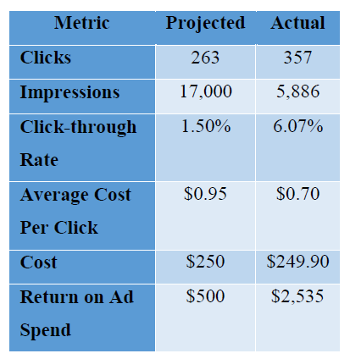
Macro-level Results
914% ROAS
Exceeded their 100% expected Return on Ad Spend
12.71% increase
In website sessions during the campaign
Notes:
Begin COnrad

Slide 11
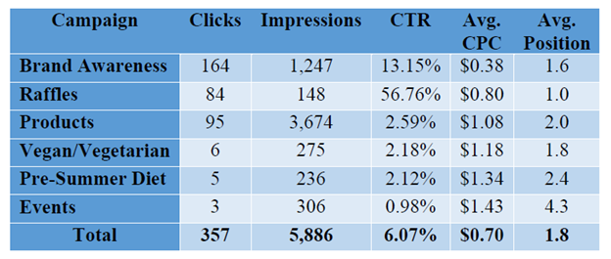
Campaign Performance

Slide 12
Failures
Events campaign paused
for Tom Tom Founder’s Festival and City Market ad groups due to high cost of first page bid
The City Market ad group only generated 2 clicks out of 300 impressions for an average CPC of $1.66 and CTR of 0.67%
Ad groups that contained keywords for competitors resulted in CTR and average CPC of 1.56% and $1.24, respectively
The Spring Cleanse ad group within the Pre-Summer/Spring Diet campaign only had 25 impressions over a two-week period
Failed to reach goal of 17,000 impressions because team overestimated seasonality of juice cleansing
Notes:
Failures: The Events campaign was paused for both the Tom Tom Founder’s Festival and City Market ad groups due to excessive first page bid costs and low CTR. The City Market ad group only generated 2 clicks out of 300 impressions for an average CPC of $1.66 and CTR of 0.67% for the first two weeks. We also paused several ad groups that resulted in poor performance. The Competition ad group within the Brand Awareness campaign contained keywords for competitors, but resulted in a poor CTR of 1.56% and average CPC of $1.24. The Spring Cleanse ad group within the Pre-Summer/Spring Diet campaign only had 25 impressions over a two-week period, thus indicative of low search volume.
The goal of reaching 17,000 impressions was not accomplished because we overestimated the seasonality and the demand for juice cleansing
Ineffective keyword combinations included Events campaign keywords such as [city market], in which users seemed consistently uninterested in TJL’s exclusive promotion. Some keywords also had extremely high first page bid requirements, such as [healthy smoothies] and “spring detox” due to heavy competition with other non-juice health and wellness products.

Slide 13
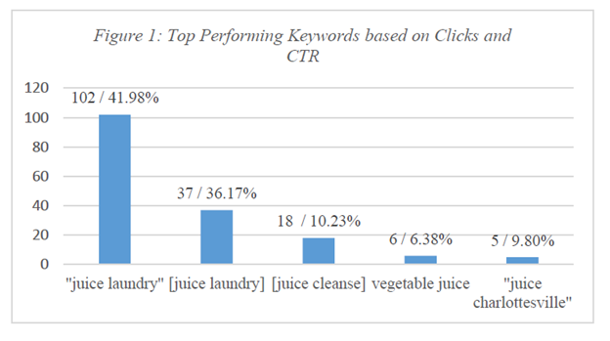
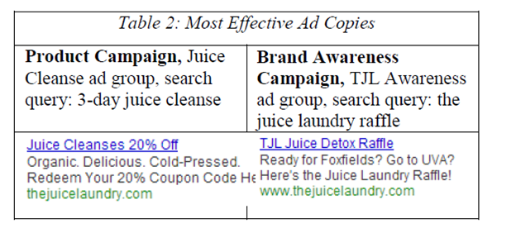
Most Successful Ad Copies & Keywords
Notes:
Overall, however, our most successful campaigns were primarily the Brand Awareness and Raffles campaigns, which boosted our overall campaign’s average CPC and CTR from $1.02 and 2.76% from the first two weeks to $0.53 and 16.44 in the third week, respectively. These campaigns also had a positive indirect residual effect on the other campaigns as well,

Slide 14
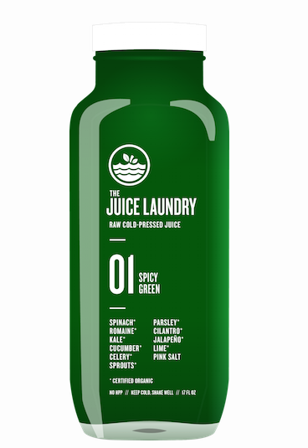
Future Recommendations
Leverage brand awareness by continuing its PPC campaign focused on branded and product keywords
Continue to leverage social media as a means to reach new customers
Regularly adjust keywords and ad copies

Slide 15
Learning Objectives
Gain a deeper understanding of how to …
Drive brand awareness and sales through digital mediums
Select effective keywords, geo-target ads, allocate effective budgets, structure campaigns and ad groups, track conversions, optimize ad copies, report metrics
Index sites with google webmaster
Do basic web page development
Do SEO

Slide 16
Team Observations
The Juice Laundry GOMC team was effective because they …
Used Keyword Planner Tool to generate new keywords
Constantly updated and added new keywords
Iteratively monitored the performance of CPC, average ad position, impressions, and clicks
Optimized bid amounts, ad copies, and landing pages to improve ad rank
Diverted more resources to their most successful campaigns: Brand Awareness and Raffles
Notes:
Success: we were able to capitalize on the increase in quality score to 10/10 for our branded keywords and top ad positions by adding additional sitelink extensions, which pointed users to the Menu and About Us pages as well

Slide 17
Thanks!
Any questions ?

